Slide 1
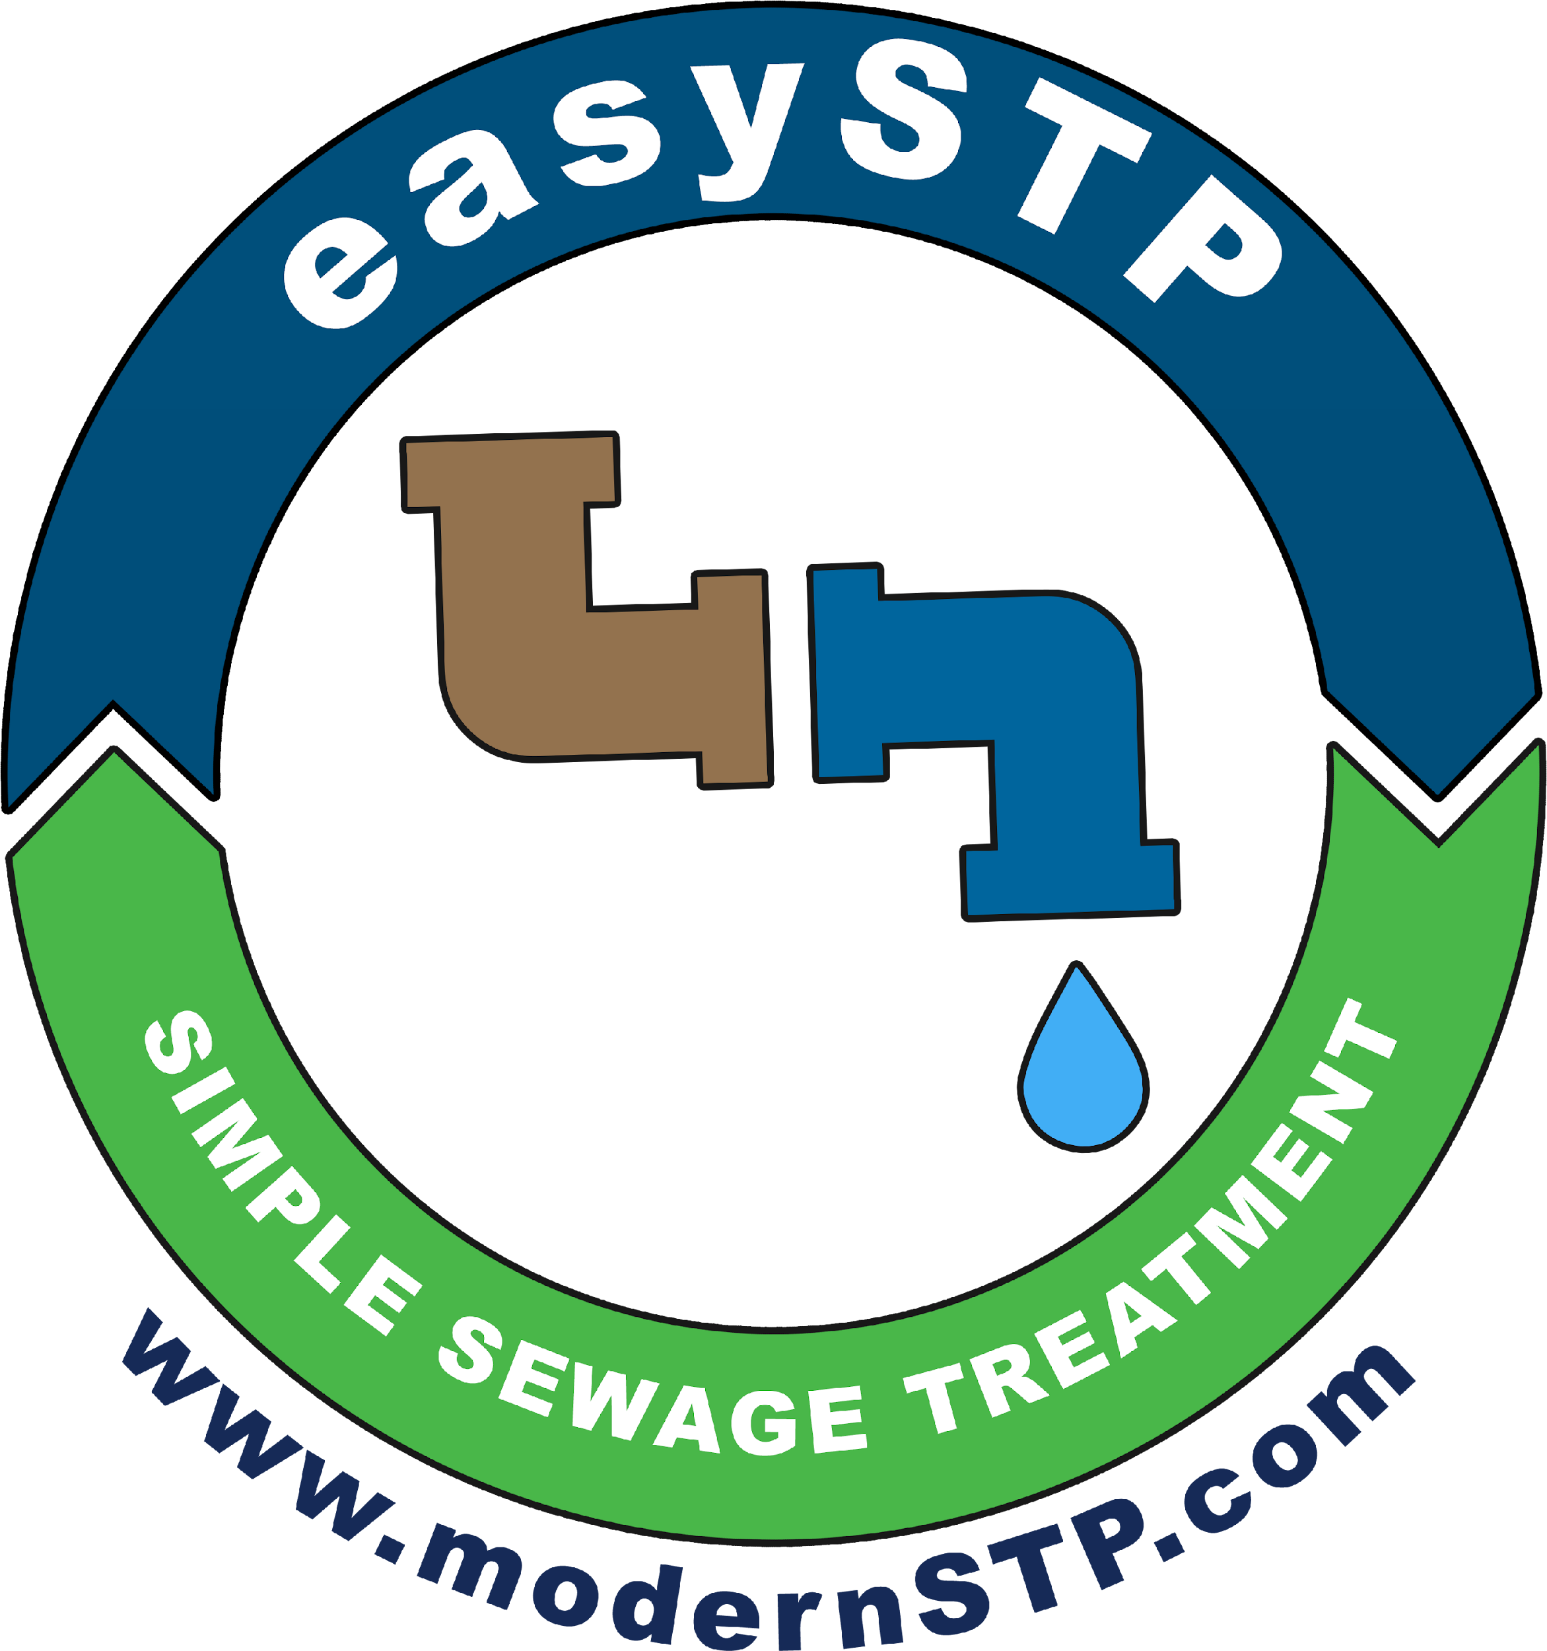
SUSTAINABLE SEWAGE TREATMENT

Slide 2

We are here to help you!

Slide 3
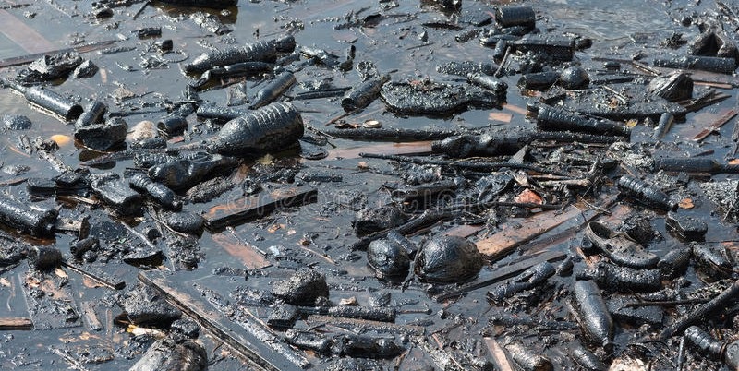
Transform this

Slide 4
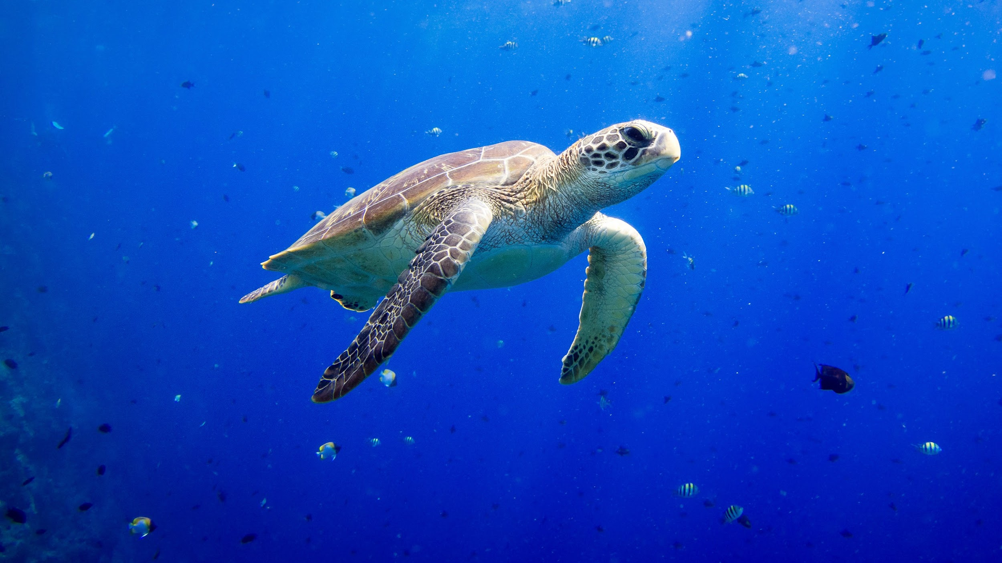
To this

Slide 5
Cost Time Effort
With
minimum

Slide 6

Without ..
Noise

Slide 7

Without ..
Foul Smell

Slide 8
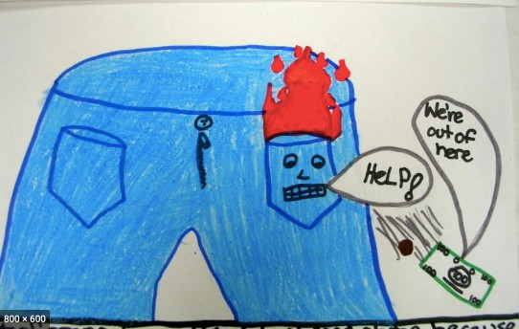
Without burning a hole in your pocket ..

Slide 9
Presenting

Slide 10


Slide 11
1 crore + STPs Sold
in 10+ countries
Japan, USA, Australia,
China, Vietnam, Malaysia, South Africa, Sri Lanka ..

Slide 12
Johkasou
Means Purification Tank in Japanese

Slide 13
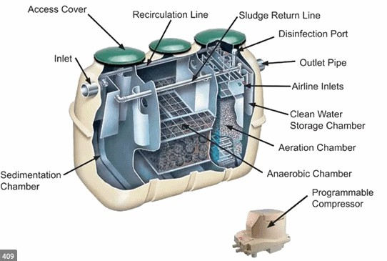

Slide 14
Now in India
As

Slide 16
What is so special about it?

Slide 17
Johkasou
Is a factory made Sewage Treatment Plant

Slide 18
Johkasou
Most popular with 1 crore plus installations.
The only proven biological process that does not require daily maintenance
Consistent High Quality treated water BOD<10
Very small foot print
TSS< 10 without any filtration
Only one moving part- air blower

Slide 19
Johkasou
70% savings on power consumption
90% savings on manpower
90% savings on mechanical maintenance
Fail Safe & Reliable
Real ‘Fit & Forget’ STP
Doesn’t use any electric pump
Every unit is factory tested for optimum performance

Slide 20
Can be installed Below Ground or Above Ground to suit site conditions

Slide 21
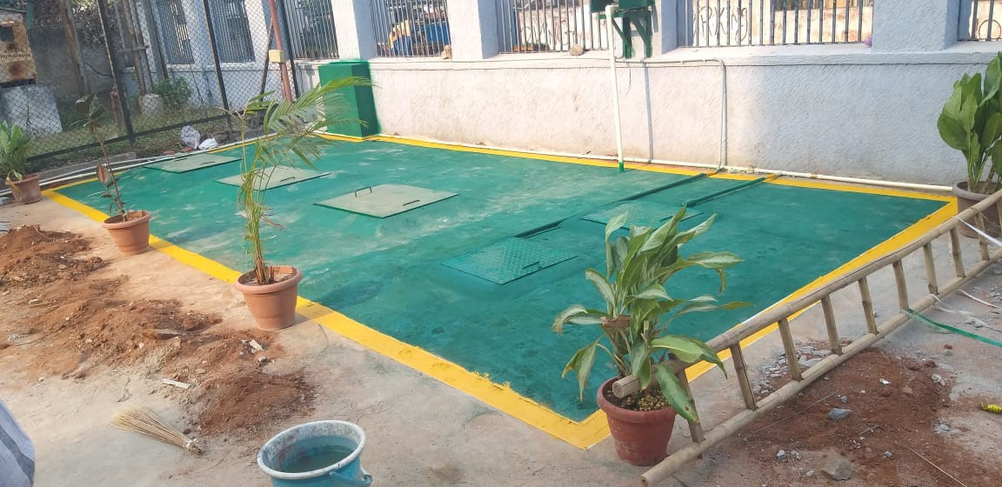
Installation suitable for vehicle passage

Slide 22
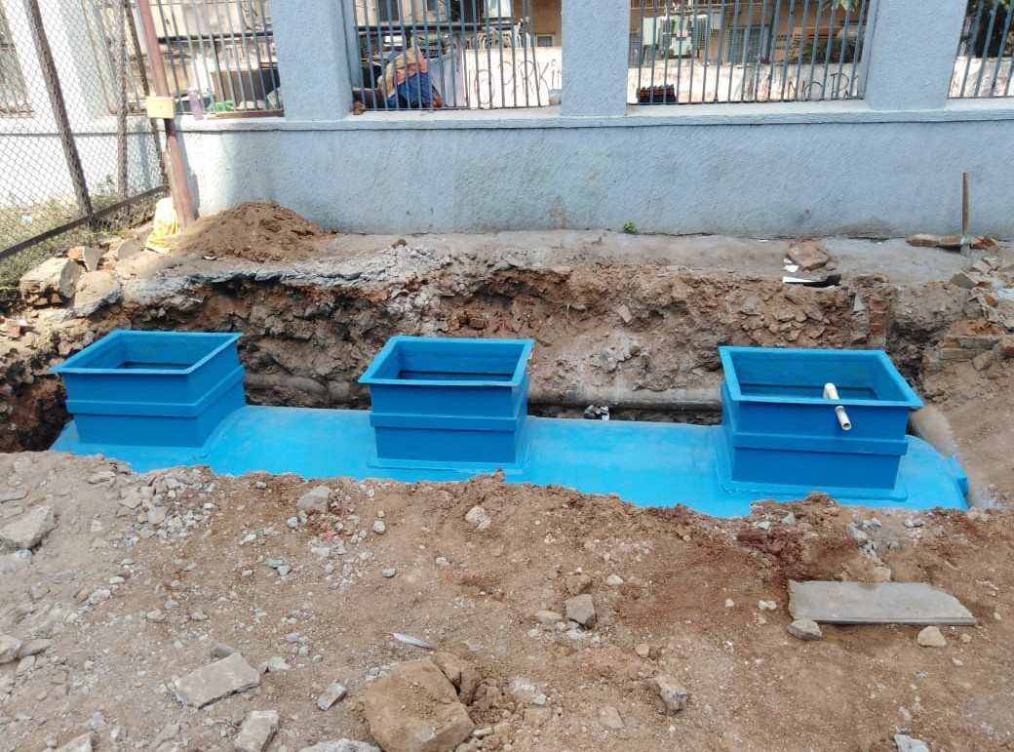
Installation suitable for vehicle passage

Slide 23
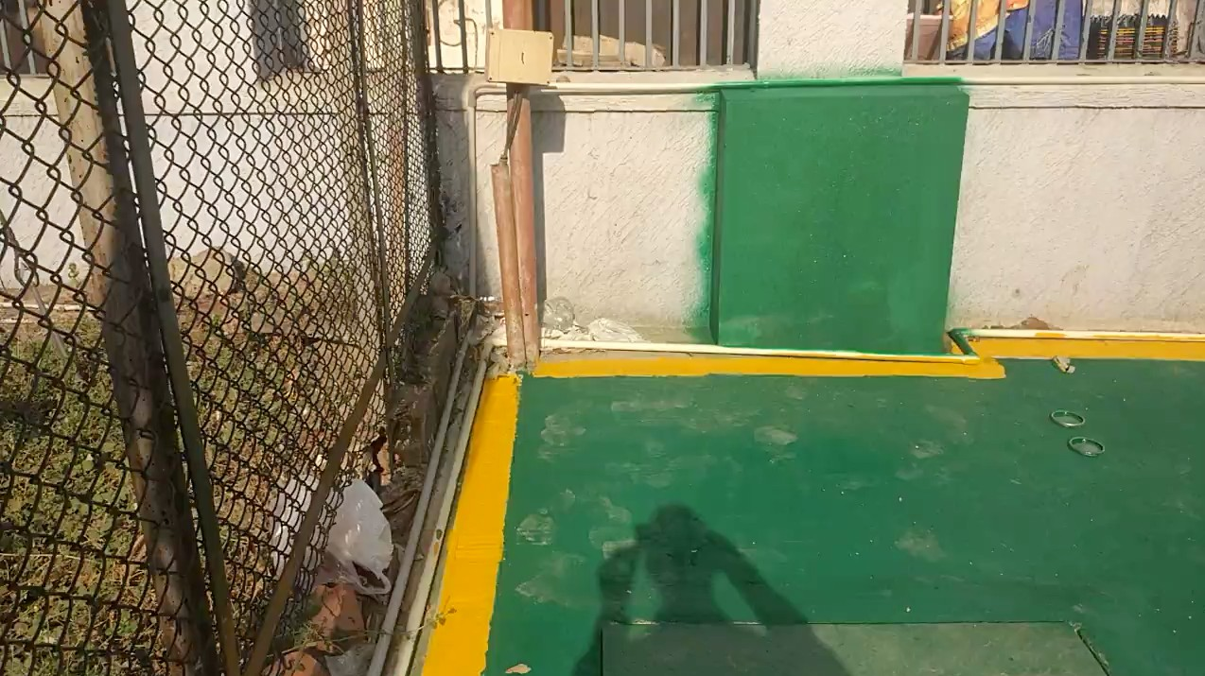

Slide 24
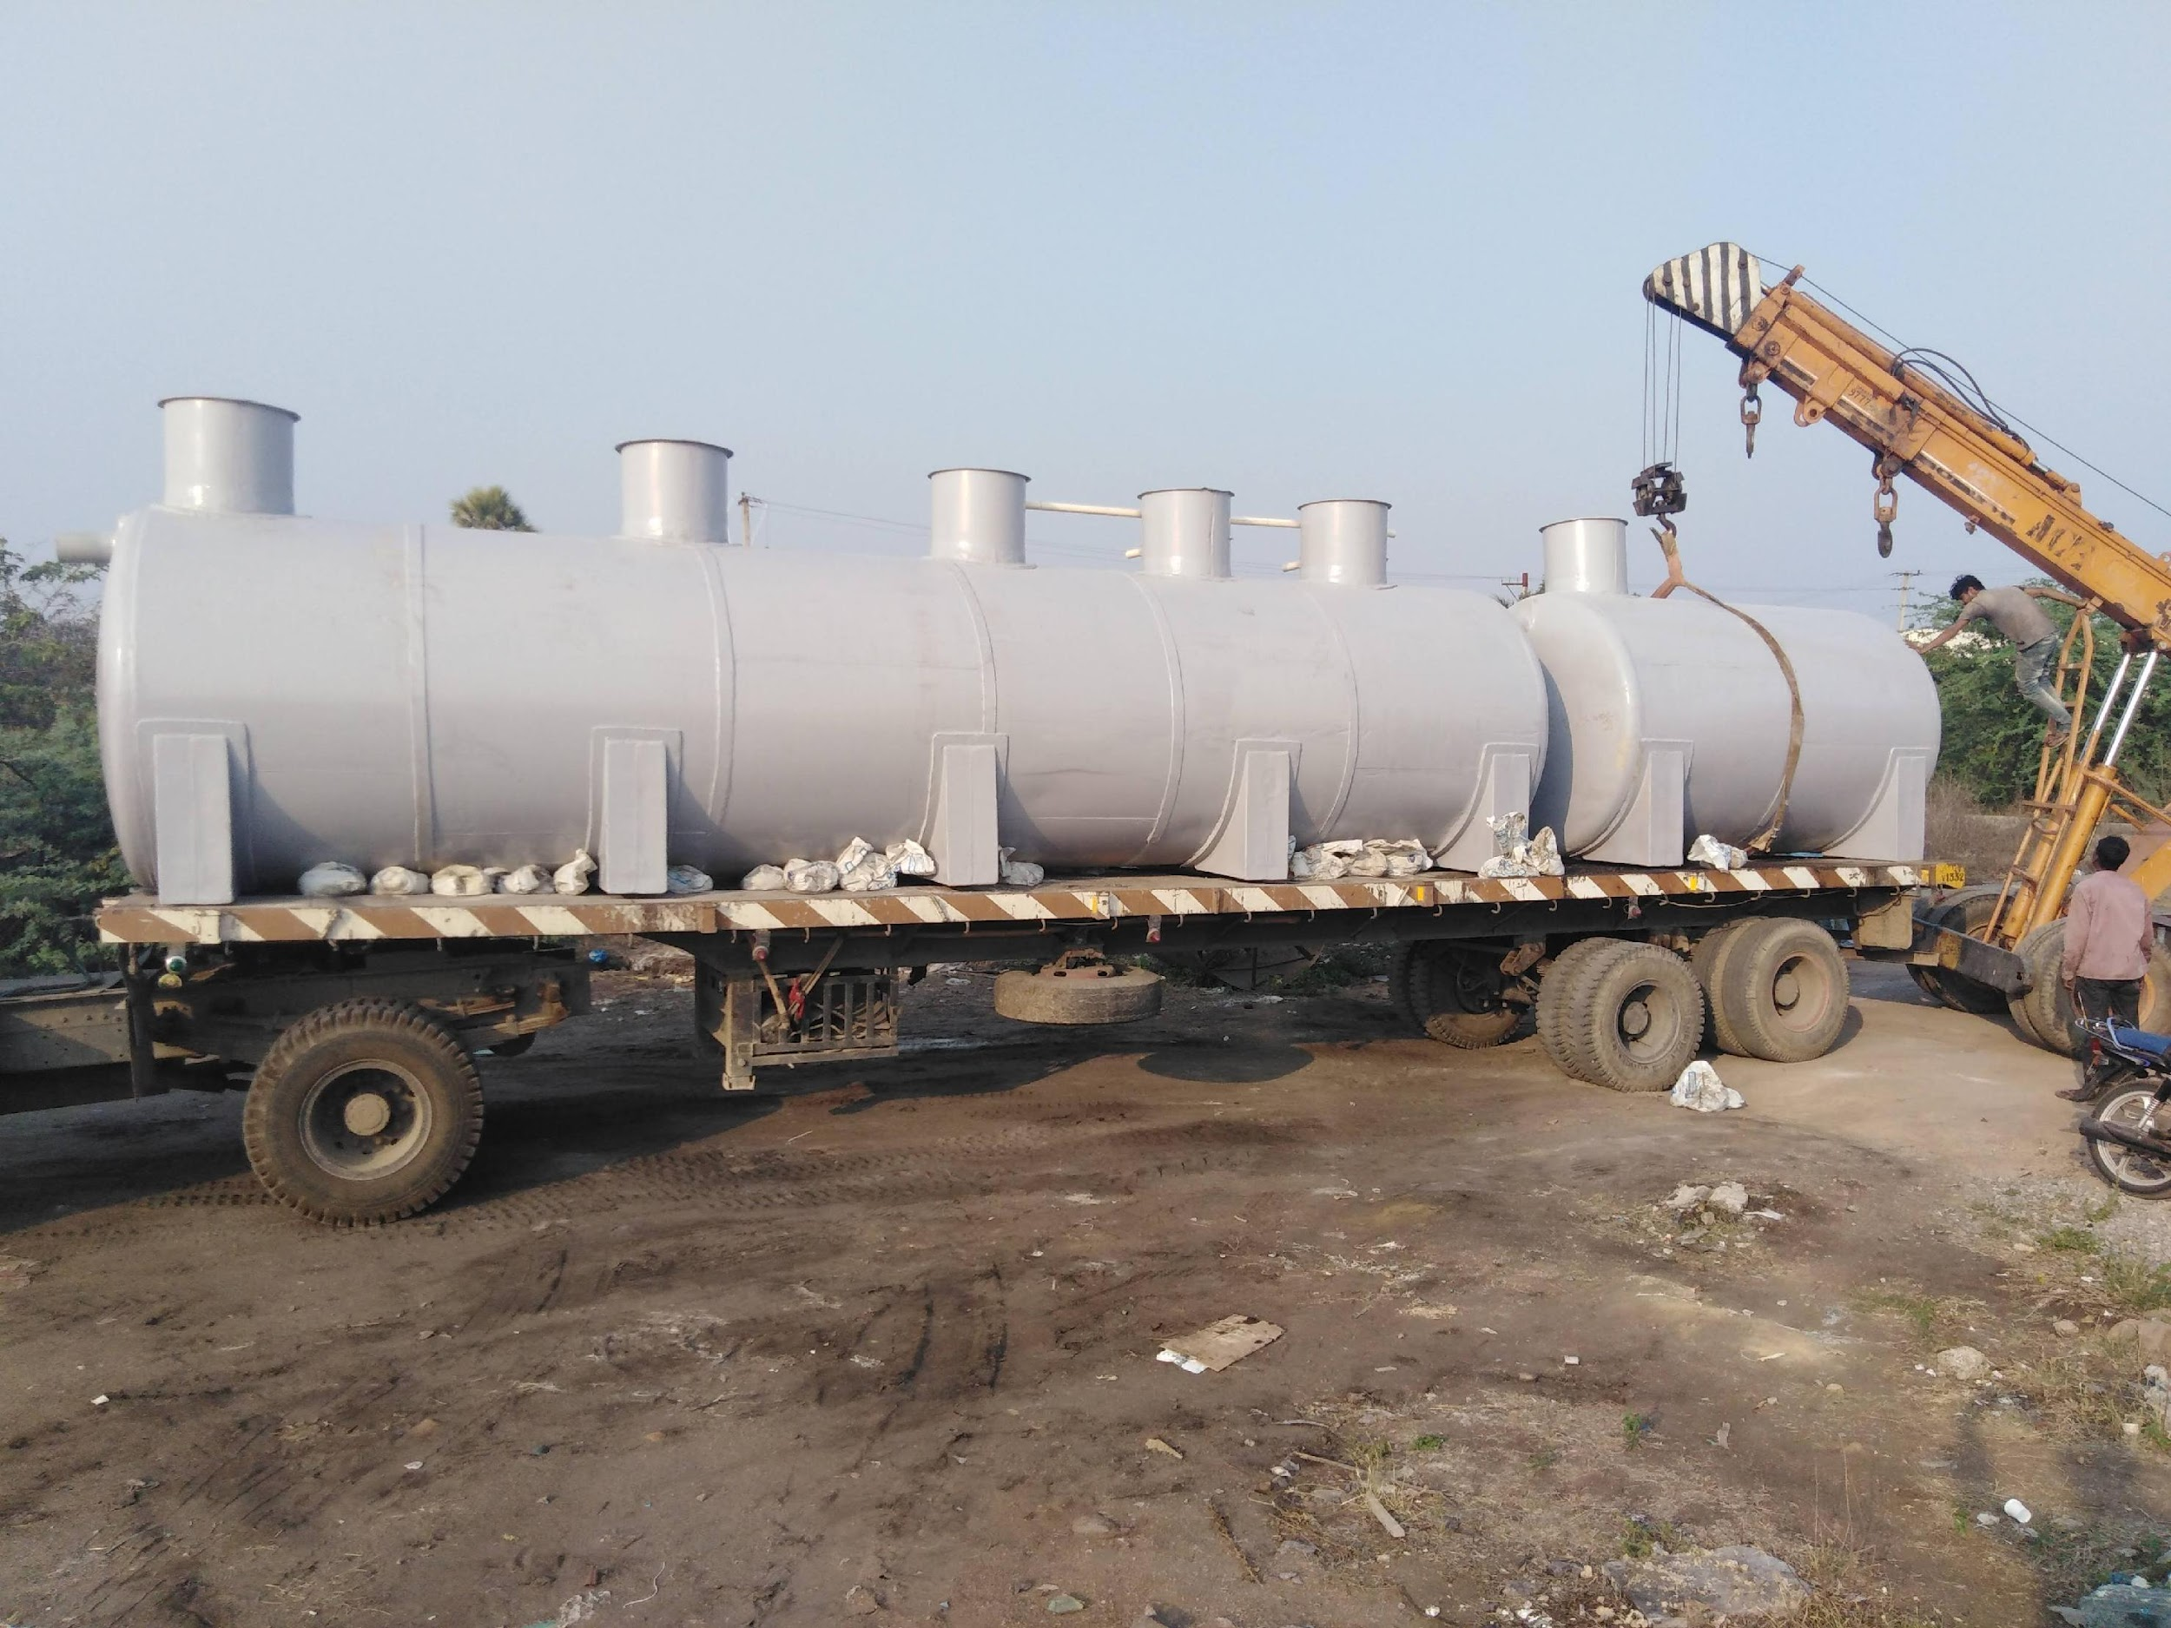

Slide 25
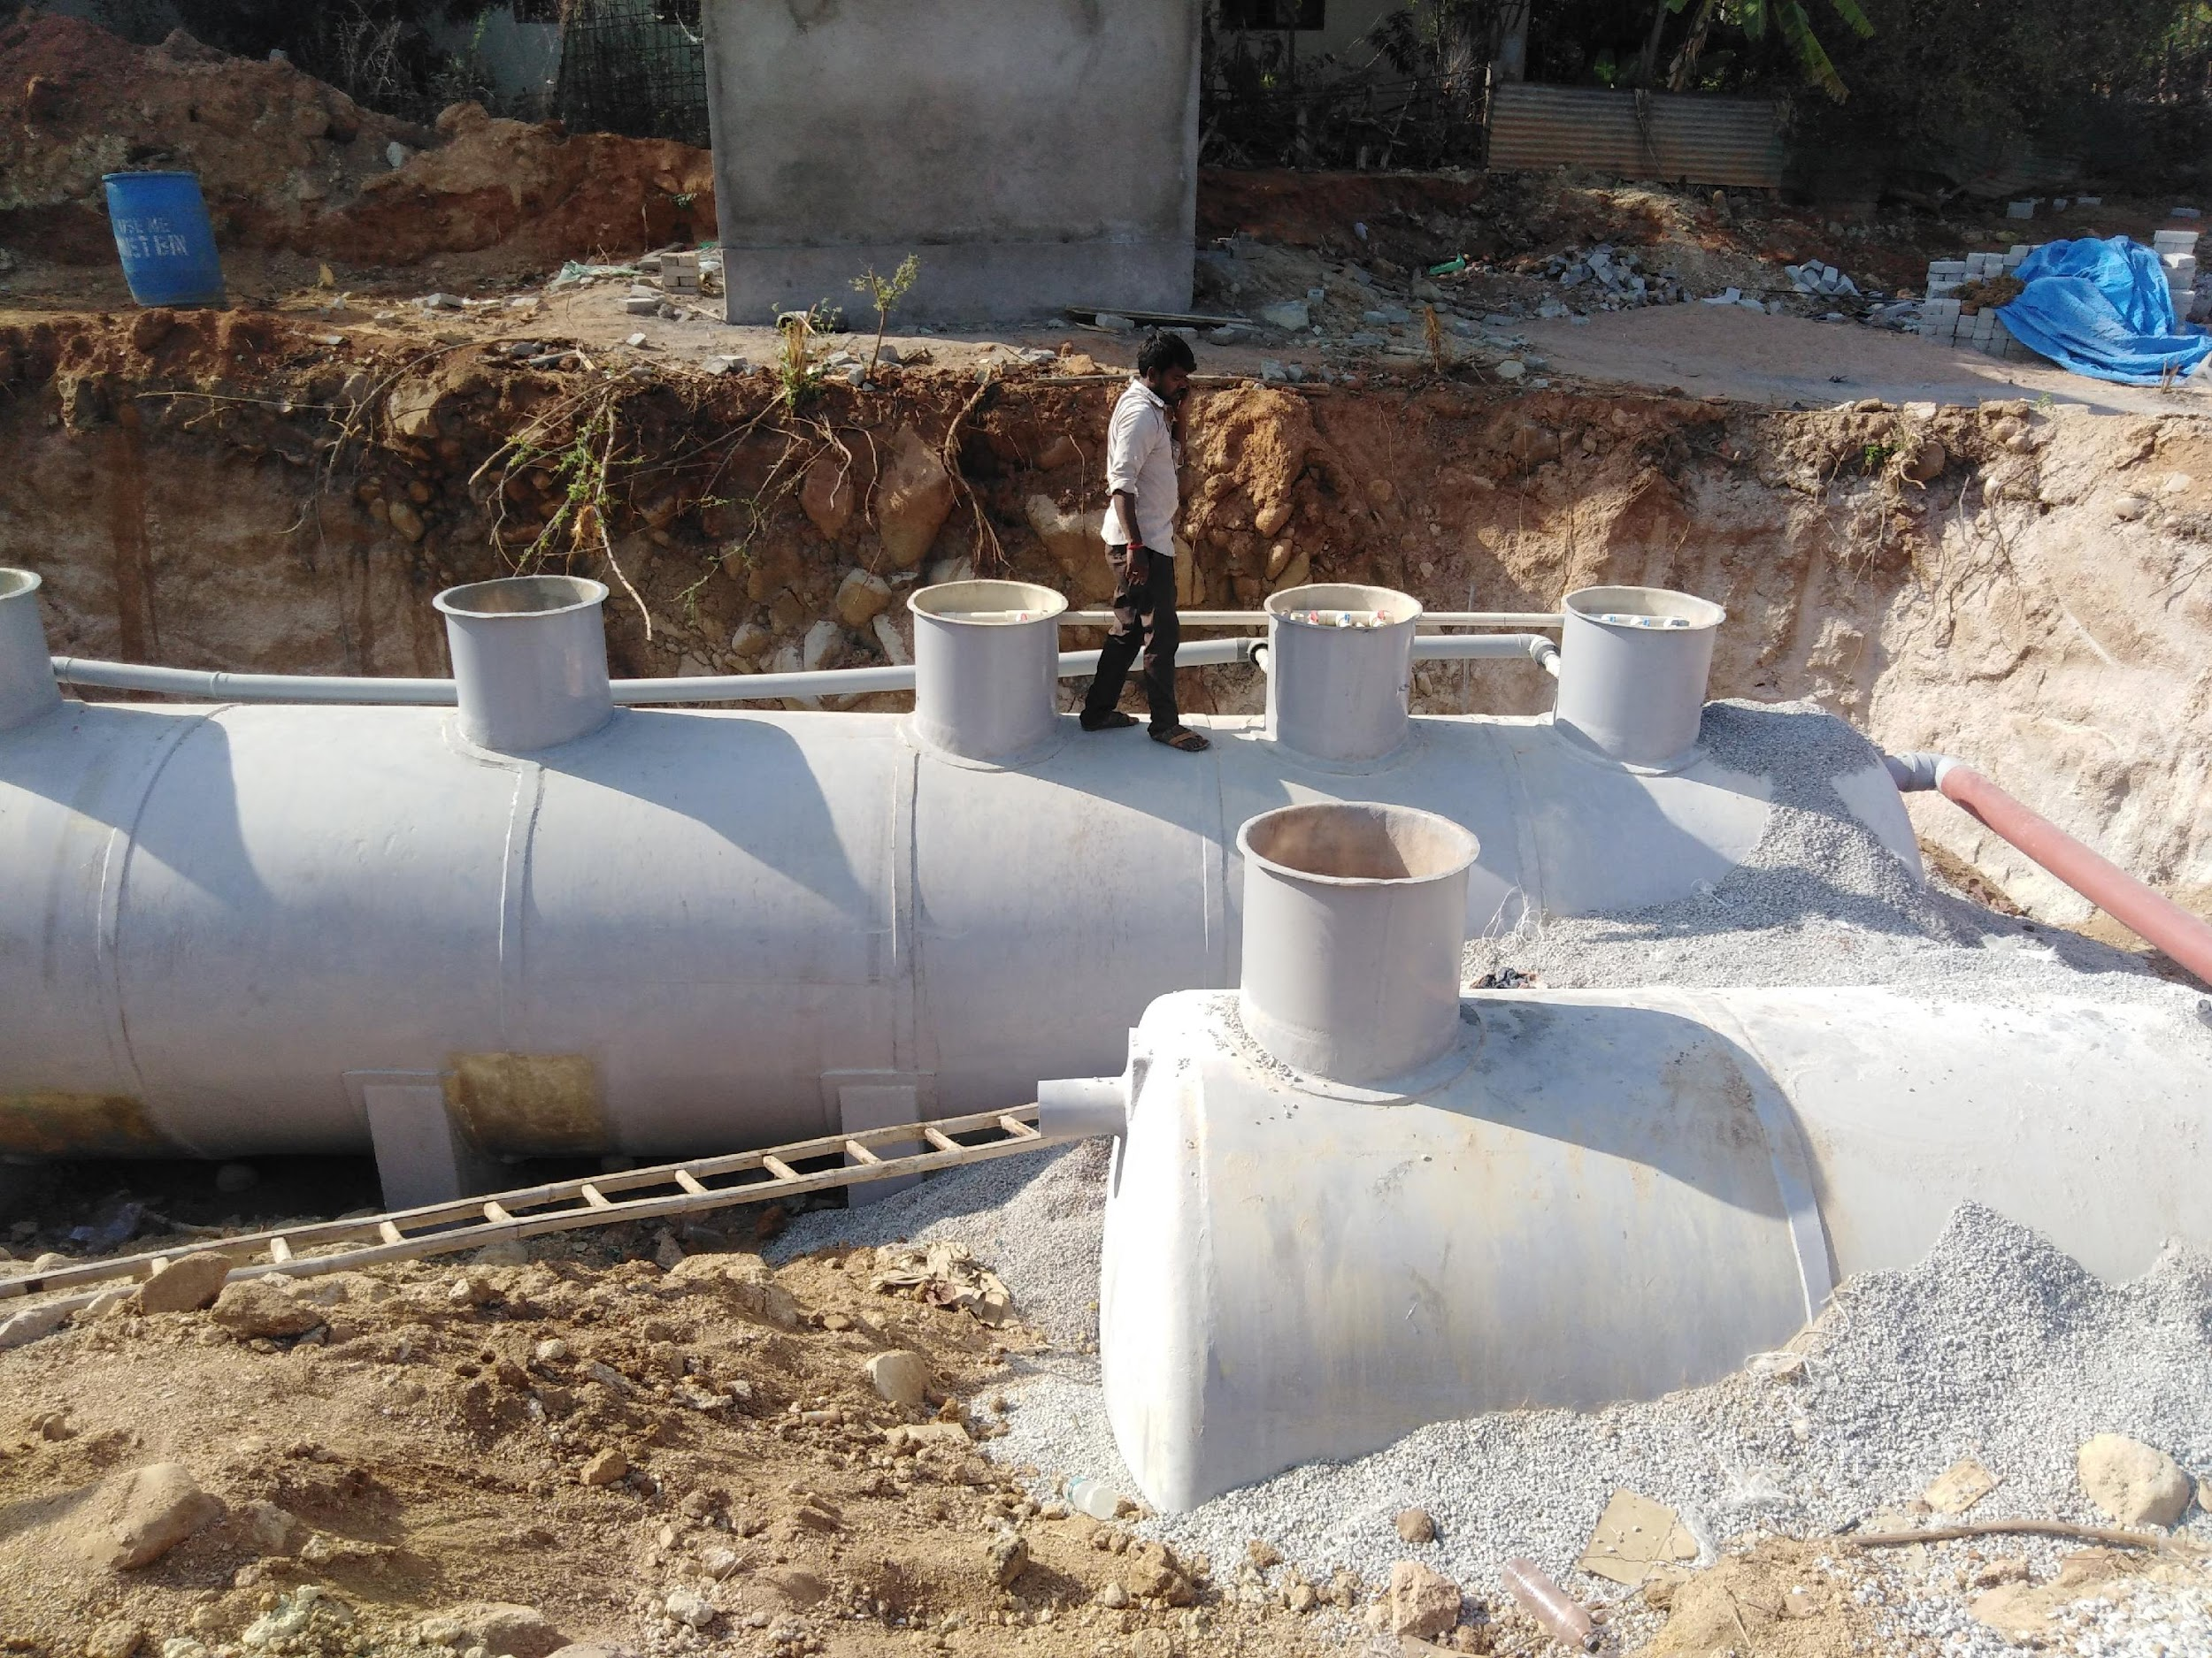
30 KLD @ University of Hyderabad

Slide 26
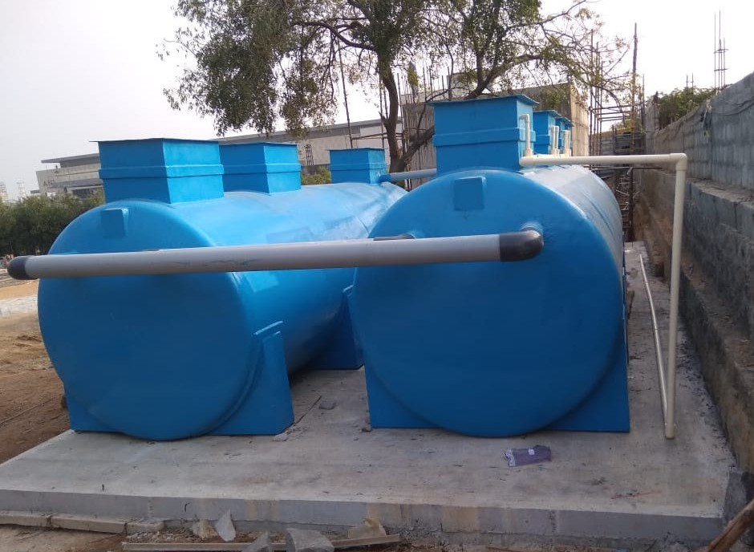
Above Ground Installation
5 0 K L D

Slide 27
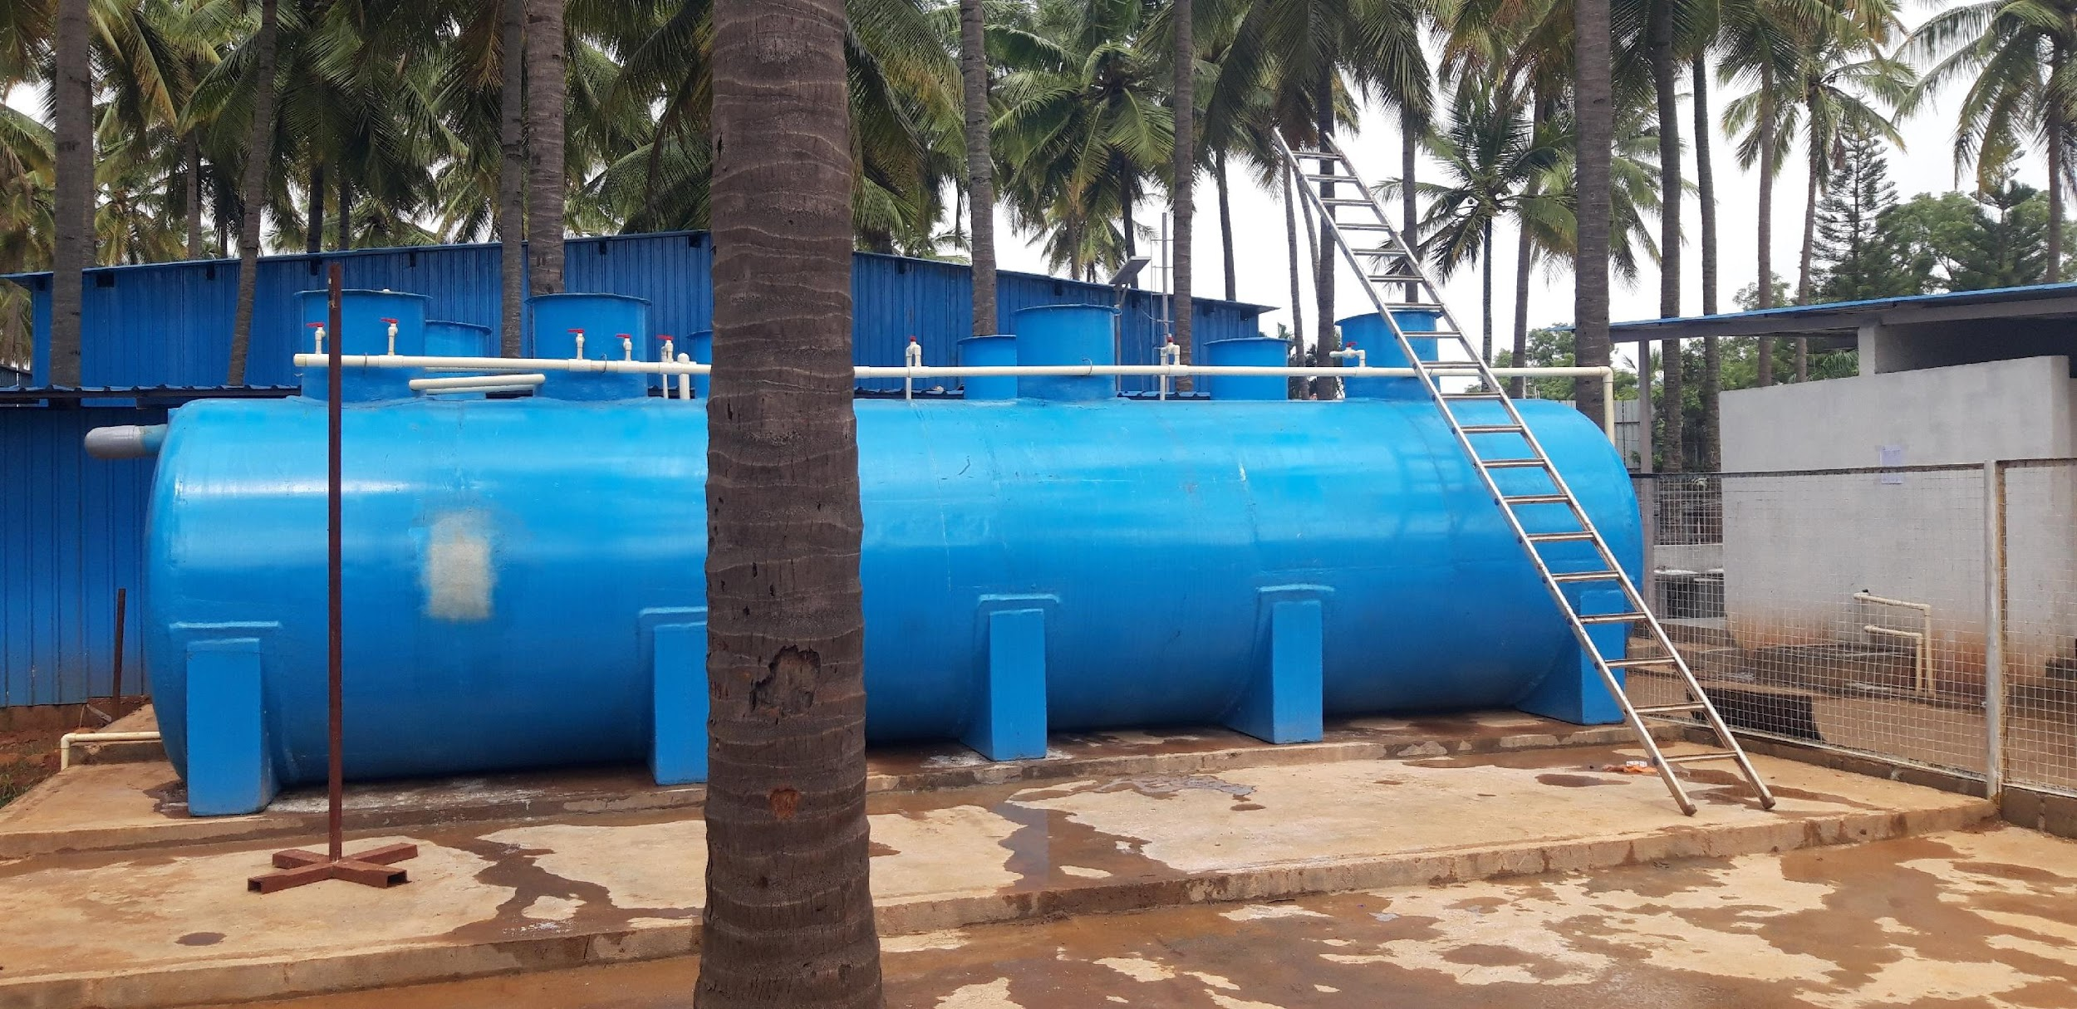
120 KLD easySTP
5 0 K L D

Slide 28
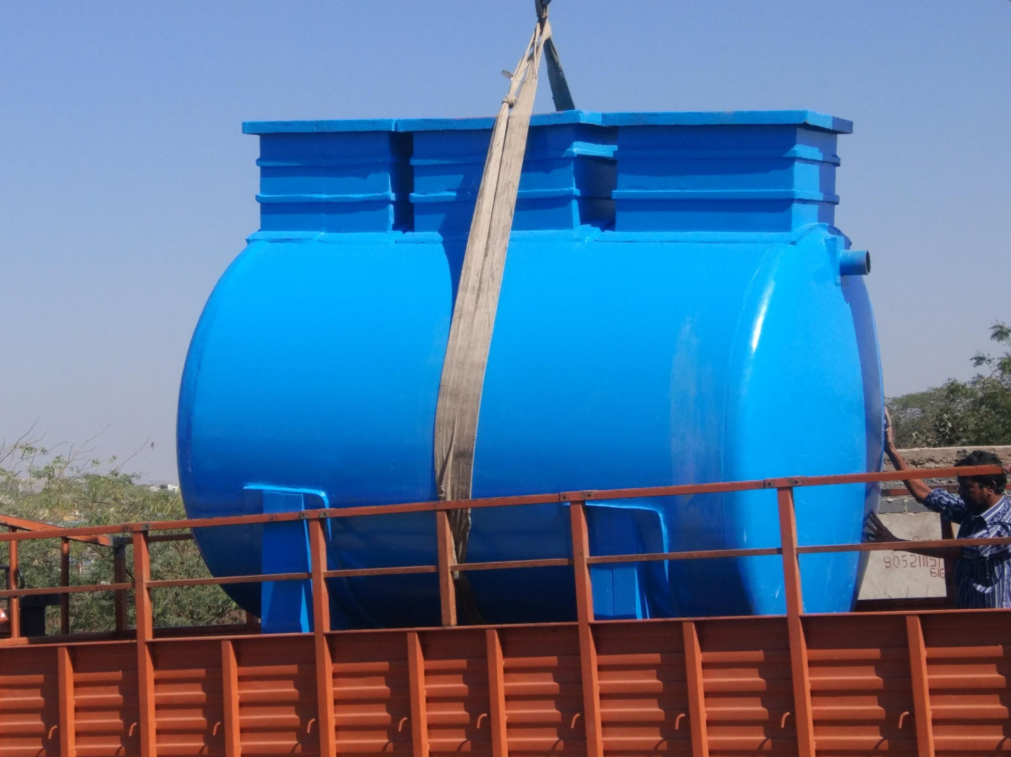

Slide 29
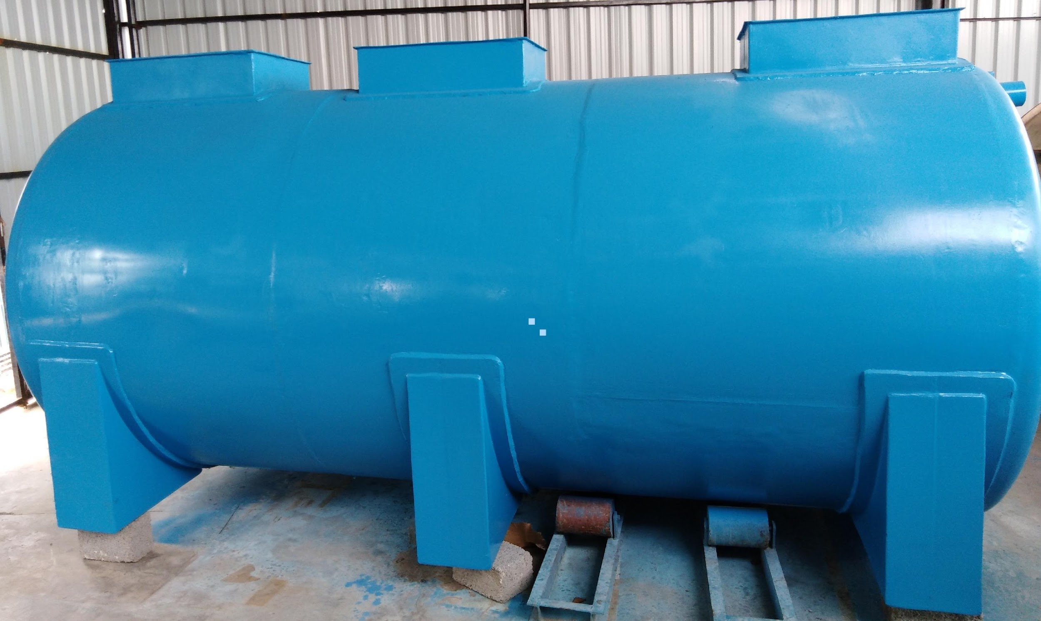

Slide 30
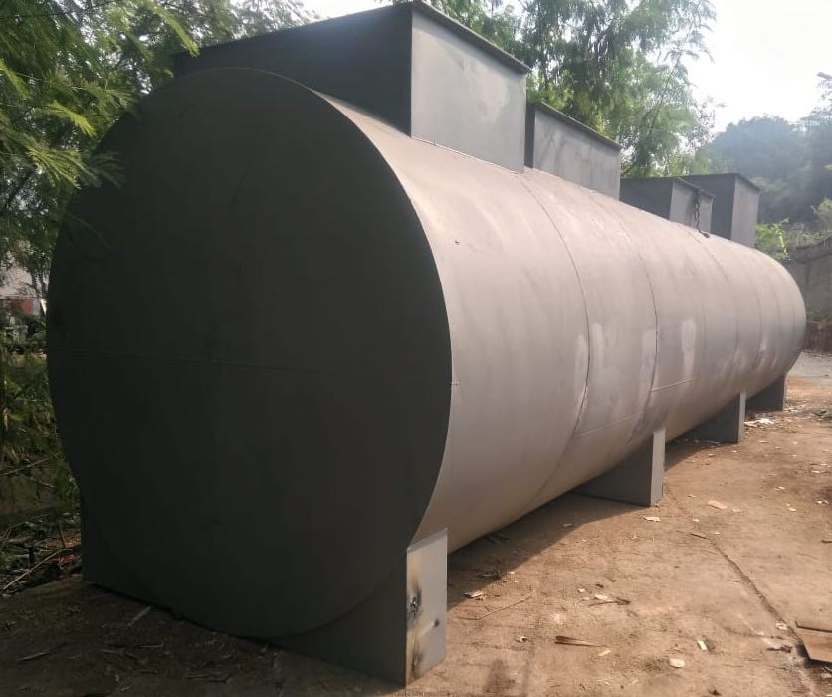
50 KLD easySTP
Hindustan Shipyard
easySTP Can also be made in MS or RCC

Slide 31
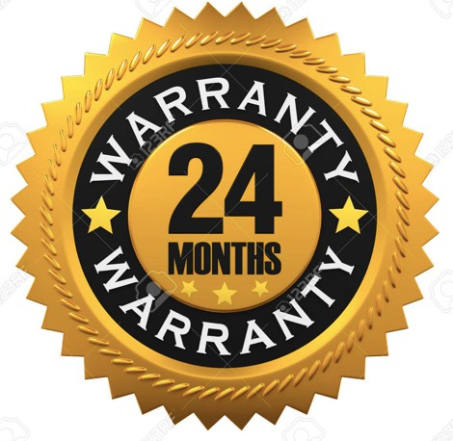
e a s y S T P i s manufactured on Semi- automatic machines ensuring high quality

Slide 32
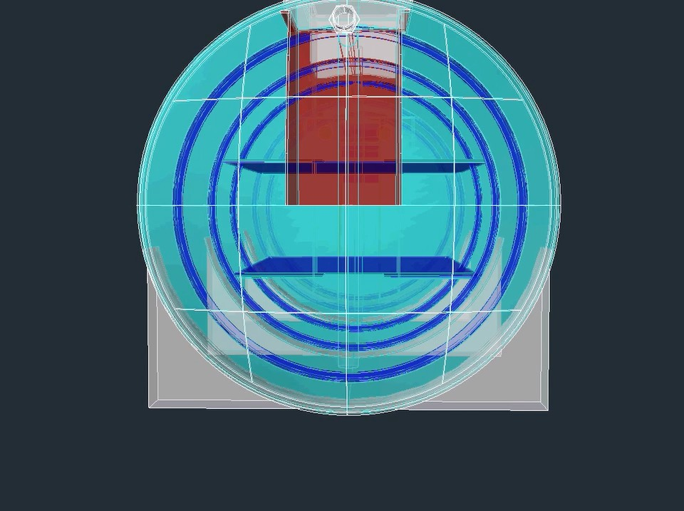
Designed in CAD

Slide 33
2, 6, 10, 15 & 20 KLD
25, 50, 75, 100 KLD
Capacities Up to 500 KLD for Municipal Use
0.5 MLD & Higher capacity can be constructed in RCC Tanks

Slide 34
Install easySTP & take the pain out of STP Ownership.

Slide 35
Call us today for a demonstration
850-100-6000
www.modernstp.com sales@modernstp.com

